Slide 1
MPLS-TE and MPLS VPNS with openflow
SIGCOMM '11 Proceedings of the ACM SIGCOMM 2011 conference
Authors : Ali Reza Sharafat, Saurav Das, Guru Parulkar, Nick McKeown
Stanford University, Stanford, CA, USA

Slide 2
Outline
MPLS VPN Connection Model
Routing table
MPLS Packet Forwarding
MPLS VPN with OpenFlow Motivation
Architecture of the physical network and the controller
Reference

Slide 3
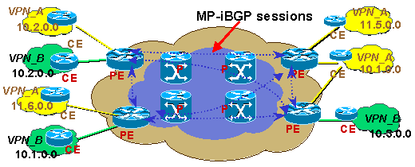
MPLS VPN Connection Model
P Router : Label Switching Router(LSR)
PE Router : Edge Label Switching Router(ELSR)
CE Router : Client Edge

Slide 4
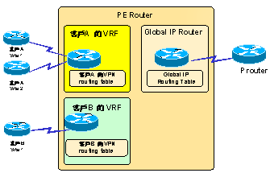
Routing table
Global Routing Table
VRF(VPN Routing & Forwarding)

Slide 5
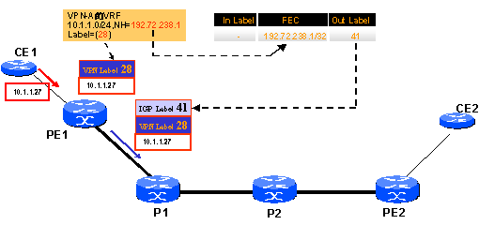
MPLS VPN Packet Forwarding

Slide 6
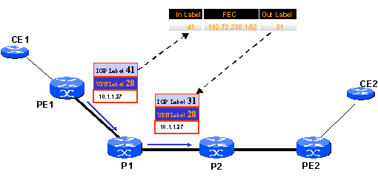
MPLS VPN Packet Forwarding(續)

Slide 7
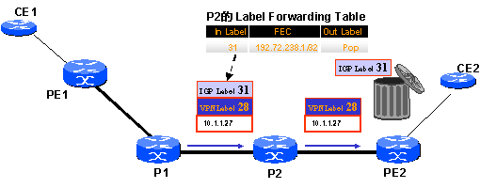
MPLS VPN Packet Forwarding(續)

Slide 8
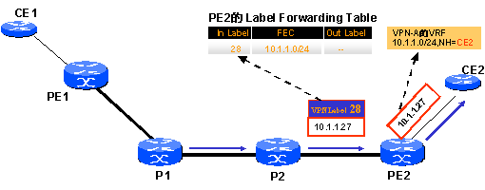
MPLS VPN Packet Forwarding(續)

Slide 9
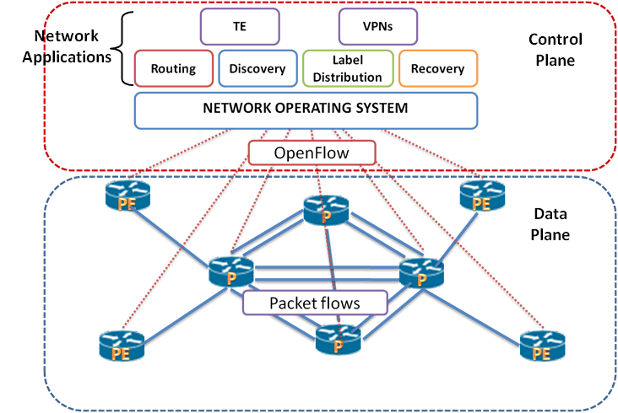
MPLS VPN with OpenFlow Motivation
Simplicity of implementation
Maintaining applications
Updating applications

Slide 10
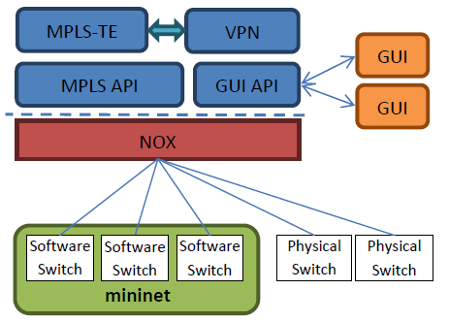
Architecture of the physical network and the controller

Slide 11
Conclusion
透過MPLS TE(Traffic Engineering)及MPLS Qos的功能保障傳輸的品質。
很容易實施

Slide 12
Reference
Seednet 教室 VPN新趨勢 MPLS VPN
MPLS with OpenFlow/SDN

